Slide 1
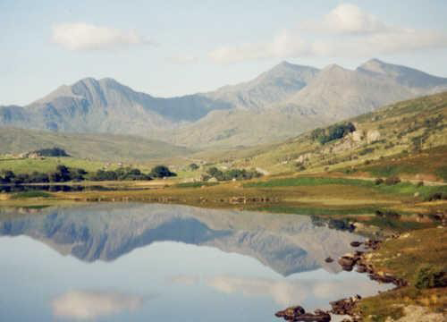
Suicide In Snowdonia,
Is it dying out?
Cathy Malcolm
(Kindly Presented By Phil Benbow)‏

Slide 2
Project Origin
Timely project, coincides with the National Action Plan to Reduce Suicide and Self Harm in Wales 2009-2014
300 suicide deaths annually in Wales
Especially prevalent amongst young people
Impetus for change high following Bridgend suicides
Media ban on reporting details of Bridgend cases, yet relationship between media reporting and suicidal behaviour unclear.

Slide 3
Project Aims
To study the incidence of suicide and attempted suicide in Snowdonia
To look at Snowdonia rates of suicide in relation to other mountainous and rural areas (national parks)‏
To see if Snowdonia is becoming a suicide hotspot
To ascertain whether suicide rates increased (copycat suicide) following the 2008 high profile suicide of Michael Todd.

Slide 4
Method
Used the YG Mountain Medicine database to identify all suicide cases, self-harm cases and suspicious deaths
25 such cases recorded over the period March 2004- November 2010
Method of suicide or self-harm, age and gender recorded
Location of suicide attempt recorded
Home address of all cases noted

Slide 5
Main Findings

Slide 6
Main Findings
METHOD – Overdose in 50% of cases
AGE – 40-45 most common age group
GENDER – 70:30 Male:Female ratio
LOCATION – 53% Found on Snowdon itself
PREMEDITATION – 63% of cases came from England
PREVIOUS ATTEMPTS -52% of cases known to mental health services prior to attempt

Slide 7
Inferences from results
Snowdonia is a suicide hotspot
Sustained increase in suicides since the Todd case supports the existence of the copycat effect
Rural location attractive to vulnerable individuals, especially men
No clear data on the incidence of suicide in other national parks but this project provides a baseline
Snowdon itself seems to hold iconic lure for suicide attempts

Slide 8
A Word on the Copycat effect
The Copycat or Werther effect describes the situation where an observer copies behaviour they have seen modelled in the media
Celebrity status of suicide victim has shown to be particularly influential
Current thinking suggests style of media reporting is key
Media is thought to have a protective effect in some cases
Many countries have now instigated media guidance to encourage 'responsible' media coverage of suicide

Slide 9
Recommendations
Trial of preventative measures to discourage suicidal behaviour
MRT teams to provide treatment for suspected overdoses
Mind Cymru offer free training in suicide intervention skills for emergency services dealing with suicidal patients
Similar research in other national parks is necessary to quantify the scale of the problem in such areas

Slide 10
References
Suicide Prevention, Summary of the Evidence (2007) National Public Health Service for Wales
Self Harm: the Short Term Physical and Psychological Management in Secondry Prevention of Self Harm in Primary and Secondary Care (2004) NICE, London
King and Frost (2005) The New Forest Suicide Prevention Initiative Crisis vol 26: 1
Phillips DP, (1974) The influence of suggestion on suicide: substantive and theoretical implications of the Werther effect American Sociological review 39: 340-354

