Slide 1
Sex
&
Post SSRI EBM Dysfunction
David Healy
Art by Billiam James

Slide 2


Slide 3
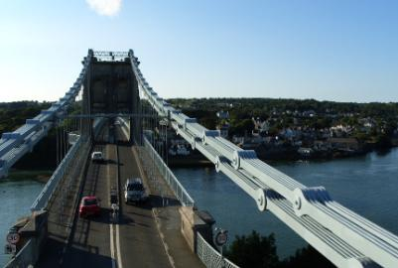

Slide 4
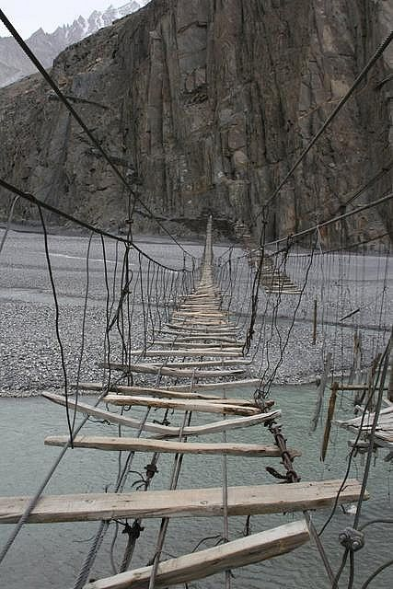

Slide 5

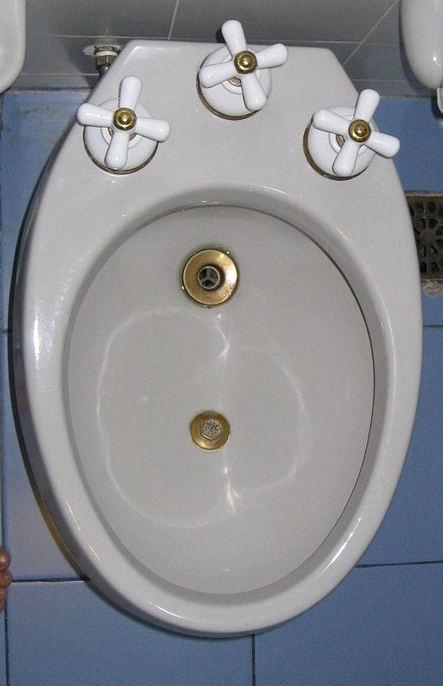

Slide 6
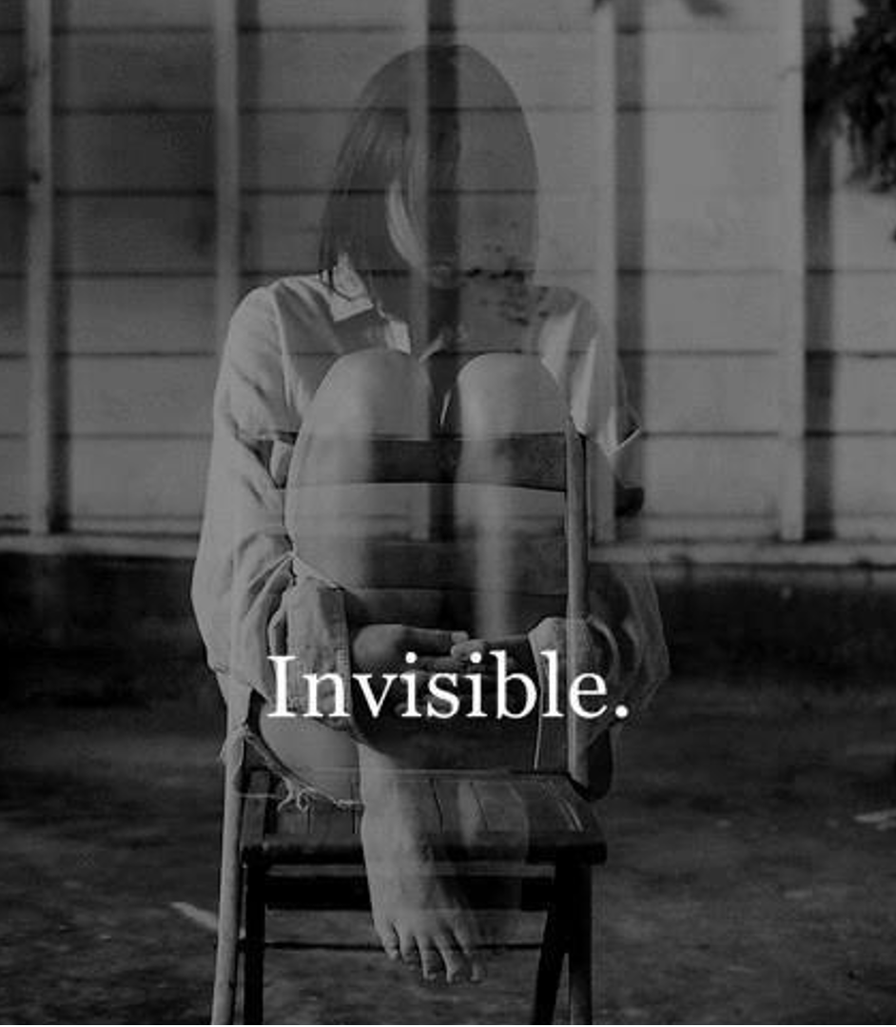

The plural of anecdotes
is not data
Journals Changed
Drugs Bulletins Changed
Guidelines - Benefits
Harms Vanished
The Scientific Task

Slide 7


Slide 8
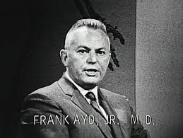
AMITRIPTYLINE
1960

Slide 9

SSRIs
GABAPENTIN
OPIOIDS
BOTOX
LIDOCAINE
LEUPROLIDE
PELVIC PHYSIOTHERAPY
ICE
CLITORIDECTOMY
PUDENDAL NERVE ABLATION
TENS
TMS
ECT

Slide 10


Slide 11
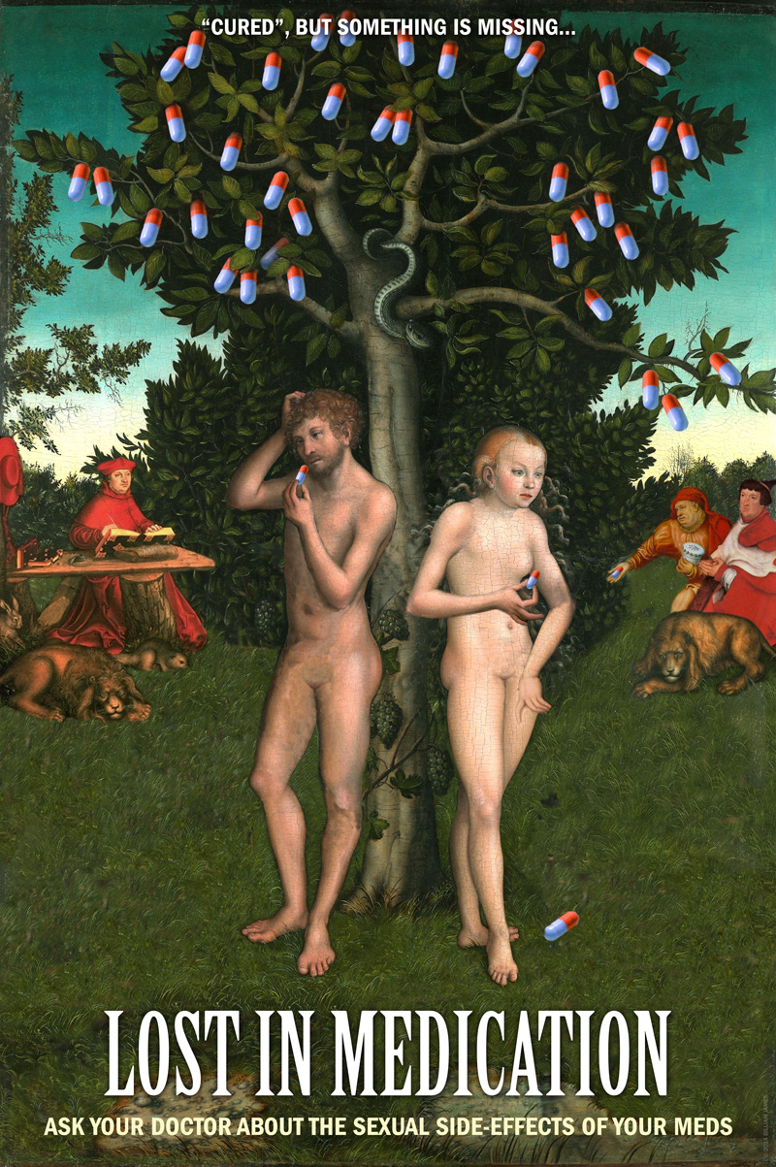
I took Finasteride for 16 years without any side-effects. Stopped 7 months ago and all hell broke loose. Some of the side-effects I got are no libido, cold testicles, pain around penis and anus, erectile dysfunction, tingling, numbness...
life is not very good these days.
I am married with beautiful children. They have lost their father. If I can do anything
to help don’t hesitate to get in touch.

Slide 12
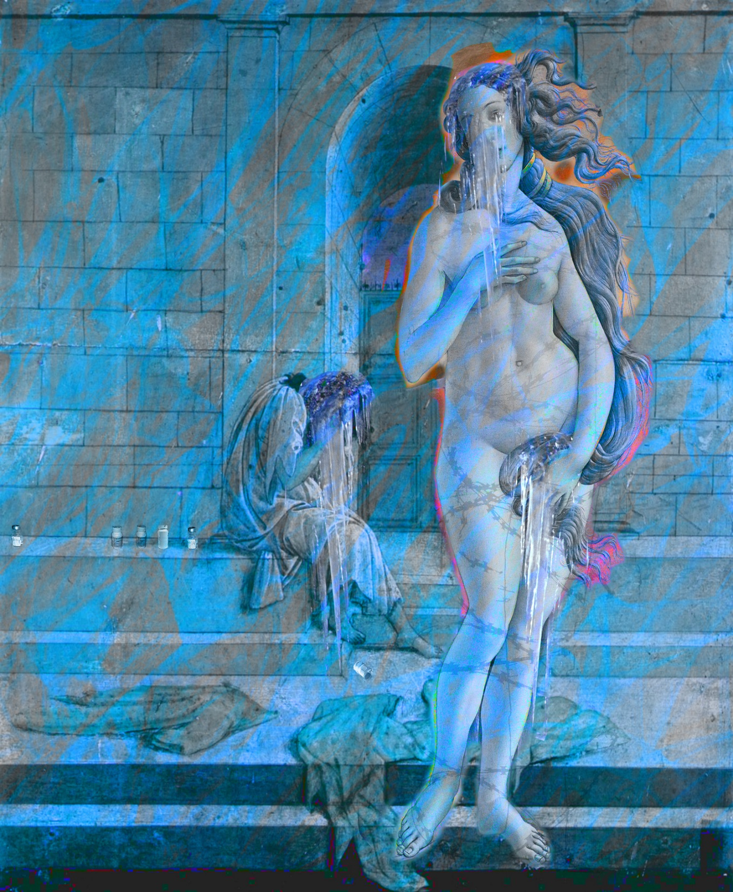
Genital Numbing
Muted Orgasm
Loss of Function
Loss of Libido
Emotional Disconnection
Post-Finasteride Syndrome
PFS – 2011
Post Retinoid Syndrome
PRSD 2014

Slide 13
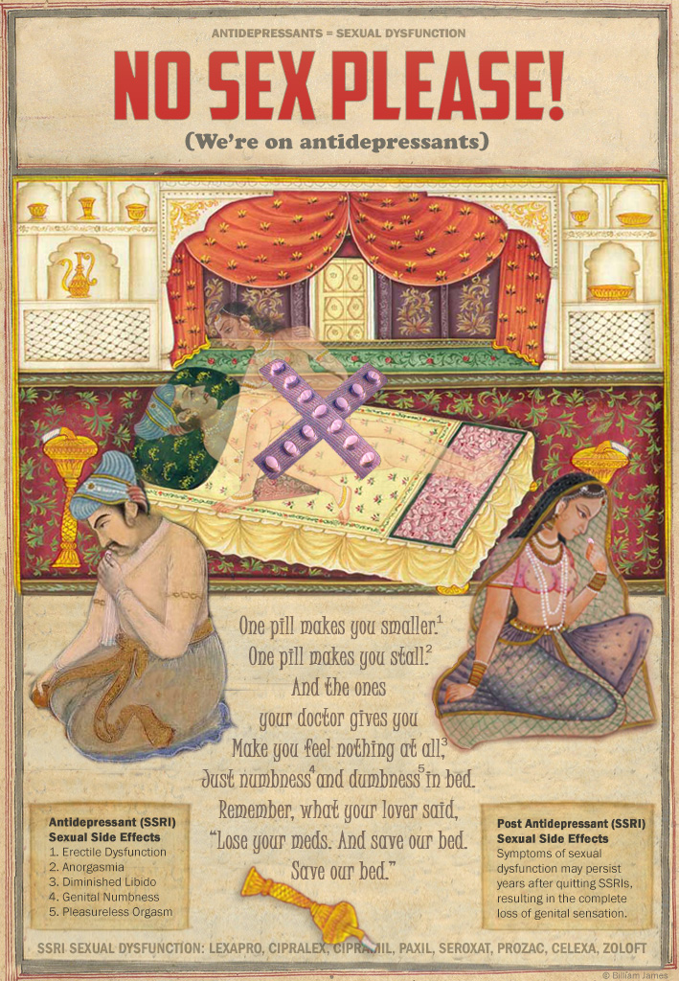
Medical Assistance in Dying (MAiD)
RxISK Prize
Nobel Prize
Sex and EBM

Slide 14
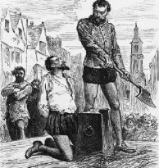
WALTER RALEIGH
1618
Hearsay
Anecdotes
EMA

Slide 15

PETITION
RISK
BENEFIT
RCTs

Slide 16


Slide 17


Slide 18
Life is a Bidet, Old Chum,
Come to the Bidet

Slide 20
A Spectre is haunting Europe… the spectre of dissent
You do not become a ‘dissident’
just because you decide one day to take up this most unusual career.
You are thrown into it by your personal sense of responsibility…
You are cast out of the existing structures and placed in a position of conflict with them.
It begins as an attempt to do your work well
and ends with being branded an enemy of society. …
The dissident is not seeking power.
He has no desire for office and does not gather votes.
He does not attempt to charm the public.
He offers nothing and promises nothing.
He can offer, if anything, only his own skin—
He offers it solely because he has no other way of affirming the truth he stands for.
His actions simply articulate his dignity as a citizen, regardless of the cost.
Vaclav Havel, The Power of the Powerless, 1978

Slide 21

You can lead a Bureaucrat to Paper
But you can’t make him think

