Slide 1
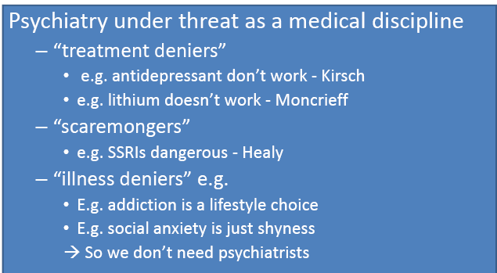
NO PSYCHIATRY WITHOUT
PSYCHOPHARMACOLOGY

